Slide 1










SMART WASTE MANAGEMENT SYSTEM
Efficient Tracking & Optimized Garbage Collection

Slide 2

PROJECT BASED LEARNING PRESENTATION-MAY-2025
(P07-Smart Waste Management System)
by
Pushpesh Pant : 2461395
Rishita Nainwal : 2461270
Rohit Rathour : 2461399
Tanushree Joshi : 2461324
under the mentorship of
Mr. Rajendra Singh Bisht
Graphic Era Hill University Bhimtal

Slide 3

To develop a Smart Waste Management System using C.
Main Goals:
Detect full bins in real time
Send console alerts
Log sanitation activities
Improve collection efficiency

Slide 4

Problem Statement
Current Issues in Waste Management:
Overflowing bins due to late collection
No real-time monitoring of bin status
Fixed schedules ignore actual fill levels
Manual tracking leads to inefficiency

Slide 5

Proposed Solution
How It Solves the Problem:
Detects full bins in real time
Sends alerts for timely collection
Logs sanitation events
Reduces manual errors and delays
Result:
No more overflowing bins
Efficient garbage collection
Less public complaints
Impact:
Cleaner streets
Healthier urban environment
Step toward smart city goals

Slide 6

Program Overview
💻 Language Used: C
Key Components:
struct WasteBin – Stores bin data: ID, location, fill %, cleaning time
bins[ ] – Predefined bins with initial values
Core Functionalities:
Update Bin Data: Fill level + hours since cleaned
Alert System: Notifies if bin is ≥80% full or uncleaned >48 hrs
Display Status: Shows current info of all bins
Log to File: Saves sanitation log to sanitation_log.txt
Sends real-time alerts
Prevents overflow & unhygienic delays

Slide 7
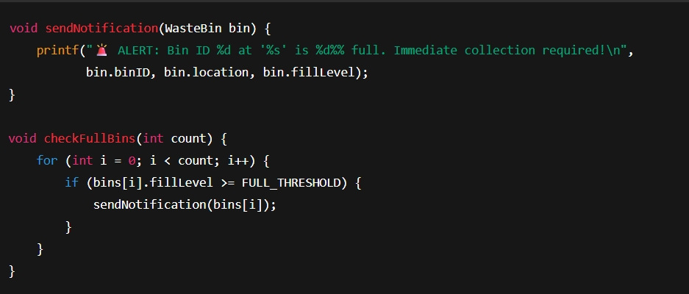
What It Shows:
Checks each bin’s fill level
Triggers an alert when bin is full (≥80%)
Alerts are shown directly on the console
Simple but powerful logic to keep waste levels under control!

Slide 8
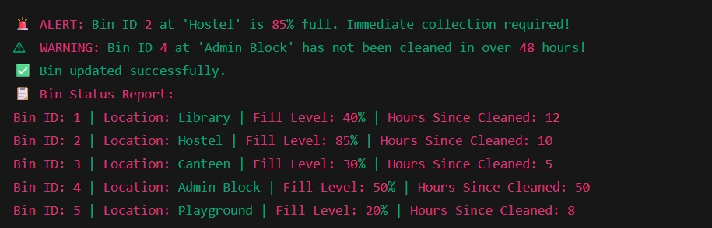


Sample Console Output
Alerts help prioritize cleaning and collection
Status reports give a clear view of all bins

Slide 9

Logs & Optimization
Sanitation Logs:
Saves bin status to sanitation_log.txt
Includes bin ID, location, fill level, and cleaning delay
Useful for historical tracking and reports
Sample Log Entry
Bin ID: 2 | Location: Hostel | Fill Level: 85% | Hours Since Cleaned: 10
Optimization Support:
Prioritizes bins needing urgent attention
Fill level ≥ 80%
Not cleaned for > 48 hours
Helps create smarter collection routes (future-ready)

Slide 10
Benefits of This Project:
Timely Waste Collection
Improved Sanitation
Instant alerts prevent overflow and delays
Regular tracking helps maintain cleanliness
Data-Driven Management
Low-Cost Solution
Logs provide useful insights for planning
Runs on basic C program without extra hardware

Slide 11

Future Scope
1.Integration with IoT Sensors
Real-time bin monitoring using hardware sensors
2.Mobile App Notification System
Alerts for cleaning staff via SMS or app
3.AI-based Route Optimization
Use AI to plan most efficient collection paths
4.Dynamic Scheduling
Adjust garbage pickup schedules based on live data
5.Dashboard for Authorities
Centralized monitoring and control panel for municipality

Slide 12

Conclusion
Summary:
Designed a simple yet effective waste monitoring system using C
Tracks bin fill levels and cleaning delays
Sends alerts and maintains logs for action and analysis
Key Takeaway:
Even basic programming can contribute to smart city solutions and improve urban hygiene.
Next Steps:
Enhance the system with sensors, automation, and data intelligence.

Slide 13

THANK YOU VERY MUCH!

